Slide 1


Lecture 16
Produced by Dr. Worldwide
Welcome to the 305
~
~

Slide 2

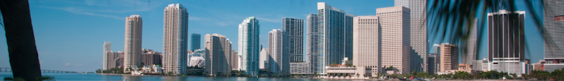
Excel for Goal Programming
Builds off linear programming using Excel Solver
Solve the linear program multiple times with different objective functions
Go in order of priority
After finding the optimal solution, we add the optimal value attained in the first objective function as a new constraint and move on to the next objective function
Possible that while solving for a given priority, we simultaneously optimize other lower ranked priorities

Slide 3
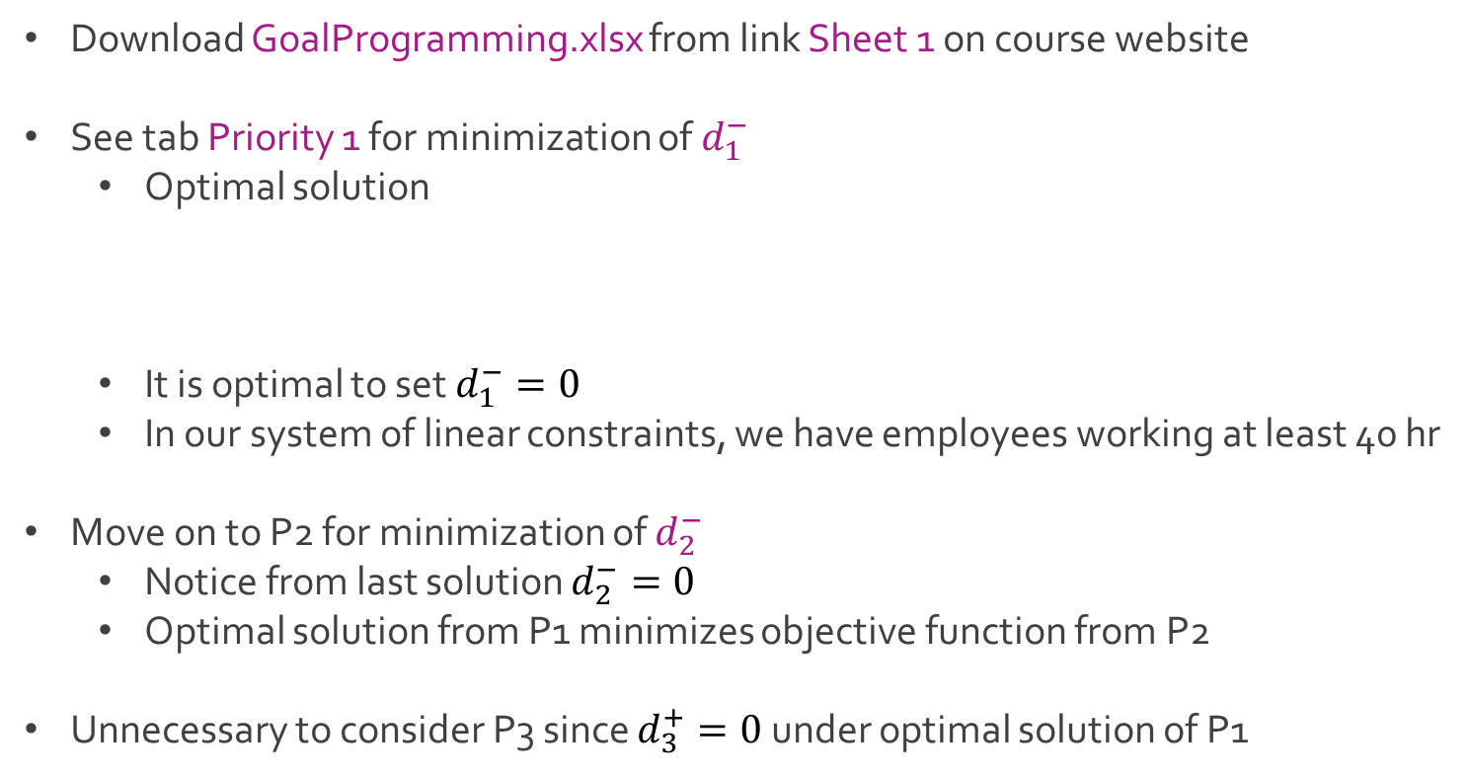
Ex: Beaver Creek Pottery
Download GoalProgramming.xlsx from link Sheet 1 on course website
See tab Priority 1 for minimization of $d_{1}^{−}$
Optimal solution
It is optimal to set $d_{1}^{−}=0$
In our system of linear constraints, we have employees working at least 40 hr
Move on to P2 for minimization of $d_{2}^{−}$
Notice from last solution $d_{2}^{−}=0$
Optimal solution from P1 minimizes objective function from P2
Unnecessary to consider P3 since $d_{3}^{+}=0$ under optimal solution of P1
$x=15 y=20 d_{1}^{+}=15 d_{4}^{+}=5 d_{5}^{−}=15$
$d_{1}^{−},d_{2}^{−},d_{2}^{+},d_{3}^{−},d_{3}^{+},d_{4}^{−},d_{6}^{−}=0$

Slide 4
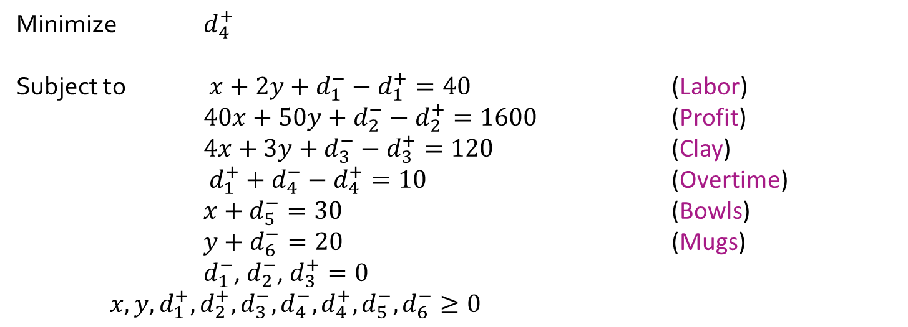
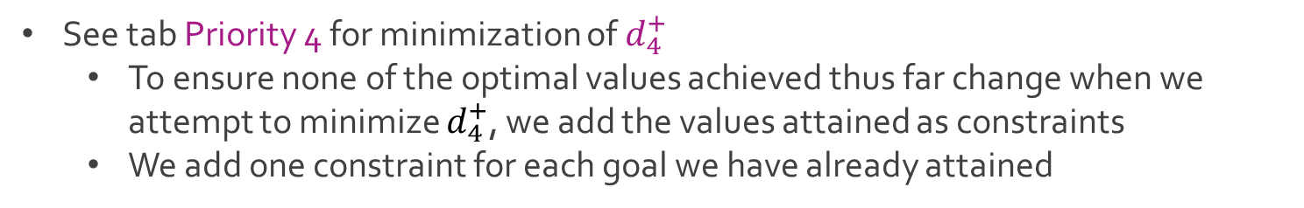
Ex: Beaver Creek Pottery
See tab Priority 4 for minimization of $d_{4}^{+}$
To ensure none of the optimal values achieved thus far change when we attempt to minimize $d_{4}^{+}$, we add the values attained as constraints
We add one constraint for each goal we have already attained
Minimize $d_{4}^{+}$
Subject to $x+2y+d_{1}^{−}−d_{1}^{+}=40$ (Labor)
$40x+50y+d_{2}^{−}−d_{2}^{+}=1600$ (Profit)
$4x+3y+d_{3}^{−}−d_{3}^{+}=120$ (Clay)
$d_{1}^{+}+d_{4}^{−}−d_{4}^{+}=10$ (Overtime)
$x+d_{5}^{−}=30$ (Bowls)
$y+d_{6}^{−}=20$ (Mugs)
$d_{1}^{−}$, $d_{2}^{−}$, $d_{3}^{+}=0$ $x,y,d_{1}^{+},d_{2}^{+},d_{3}^{−},d_{4}^{−},d_{4}^{+},d_{5}^{−},d_{6}^{−}≥0$

Slide 5
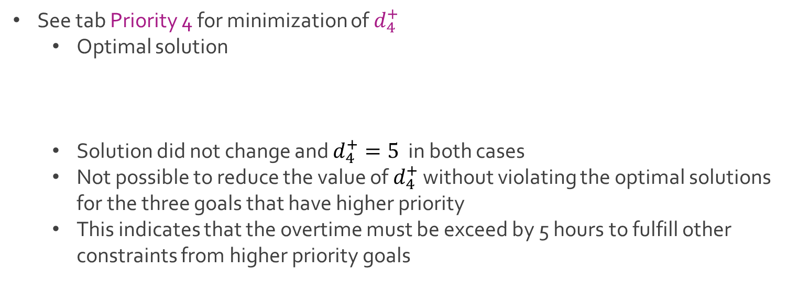
Ex: Beaver Creek Pottery
See tab Priority 4 for minimization of $d_{4}^{+}$
Optimal solution
Solution did not change and $d_{4}^{+}=5$ in both cases
Not possible to reduce the value of $d_{4}^{+}$ without violating the optimal solutions for the three goals that have higher priority
This indicates that the overtime must be exceed by 5 hours to fulfill other constraints from higher priority goals
$x=15 y=20 d_{1}^{+}=15 d_{4}^{+}=5 d_{5}^{−}=15$
$d_{1}^{−},d_{2}^{−},d_{2}^{+},d_{3}^{−},d_{3}^{+},d_{4}^{−},d_{6}^{−}=0$

Slide 6
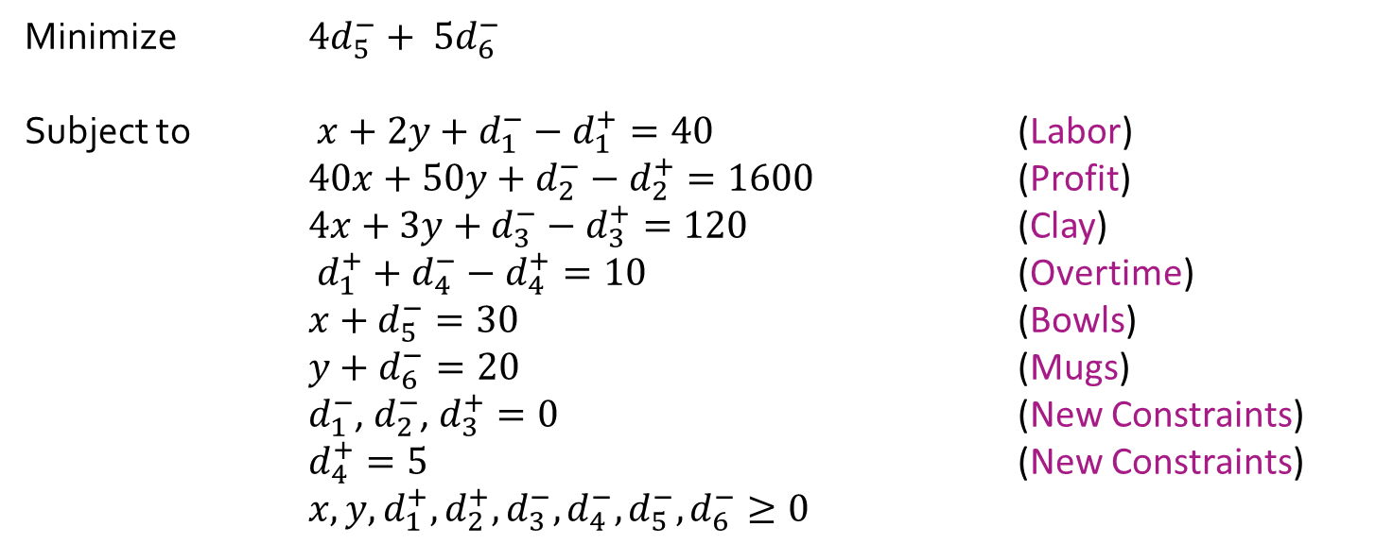
Ex: Beaver Creek Pottery
See tab Priority 5 for minimization of $4d_{5}^{−}+ 5d_{6}^{−}$
Add result from previous priority rank as a constraint
Minimize $4d_{5}^{−}+ 5d_{6}^{−}$
Subject to $x+2y+d_{1}^{−}−d_{1}^{+}=40$ (Labor)
$40x+50y+d_{2}^{−}−d_{2}^{+}=1600$ (Profit)
$4x+3y+d_{3}^{−}−d_{3}^{+}=120$ (Clay)
$d_{1}^{+}+d_{4}^{−}−d_{4}^{+}=10$ (Overtime)
$x+d_{5}^{−}=30$ (Bowls)
$y+d_{6}^{−}=20$ (Mugs)
$d_{1}^{−}$, $d_{2}^{−}$, $d_{3}^{+}=0$ (New Constraints)
$d_{4}^{+}=5$ (New Constraints) $x,y,d_{1}^{+},d_{2}^{+},d_{3}^{−}, d_{4}^{−},d_{5}^{−},d_{6}^{−}≥0$

Slide 7
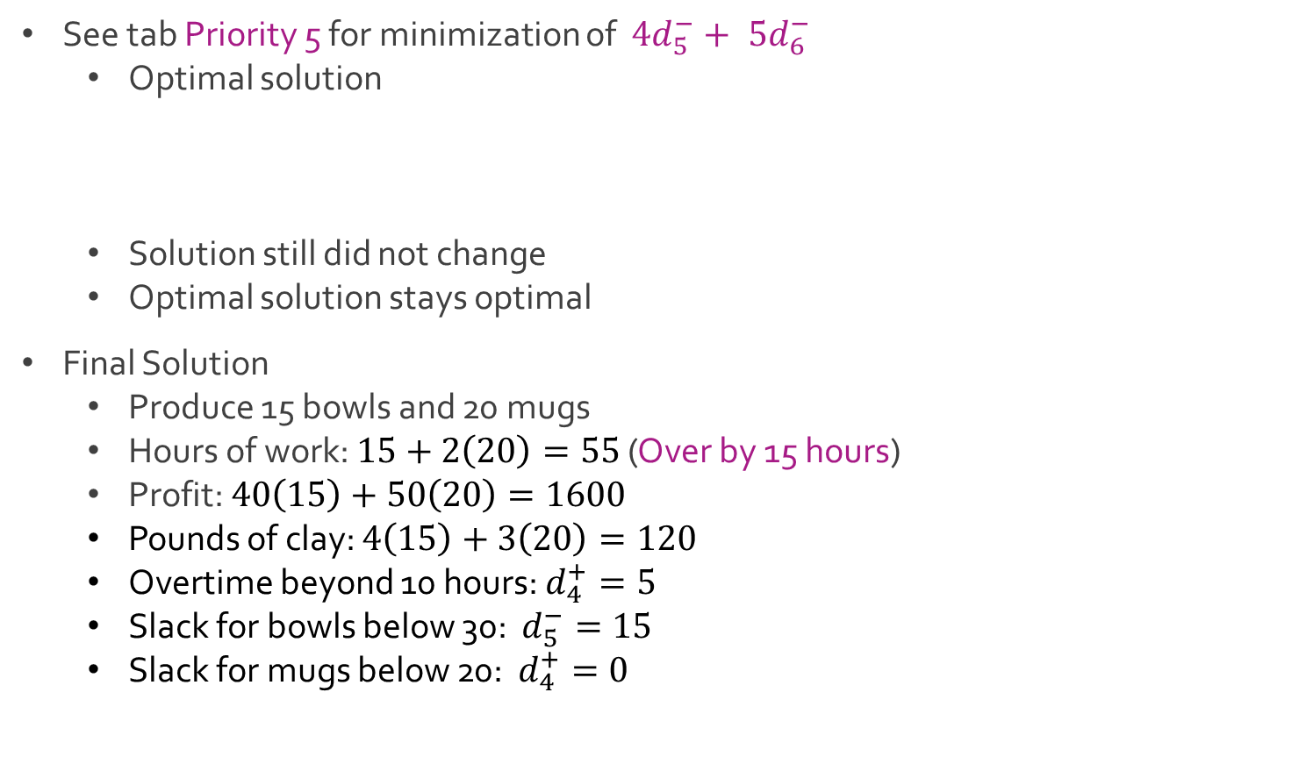
Ex: Beaver Creek Pottery
See tab Priority 5 for minimization of $4d_{5}^{−}+ 5d_{6}^{−}$
Optimal solution
Solution still did not change
Optimal solution stays optimal
Final Solution
Produce 15 bowls and 20 mugs
Hours of work: $15+2\left(20\right)=55$ (Over by 15 hours)
Profit: $40\left(15\right)+50\left(20\right)=1600$
Pounds of clay: $4\left(15\right)+3\left(20\right)=120$
Overtime beyond 10 hours: $d_{4}^{+}=5$
Slack for bowls below 30: $d_{5}^{−}=15$
Slack for mugs below 20: $d_{4}^{+}=0$
$x=15 y=20 d_{1}^{+}=15 d_{4}^{+}=5 d_{5}^{−}=15$
$d_{1}^{−},d_{2}^{−},d_{2}^{+},d_{3}^{−},d_{3}^{+},d_{4}^{−},d_{6}^{−}=0$

Slide 8
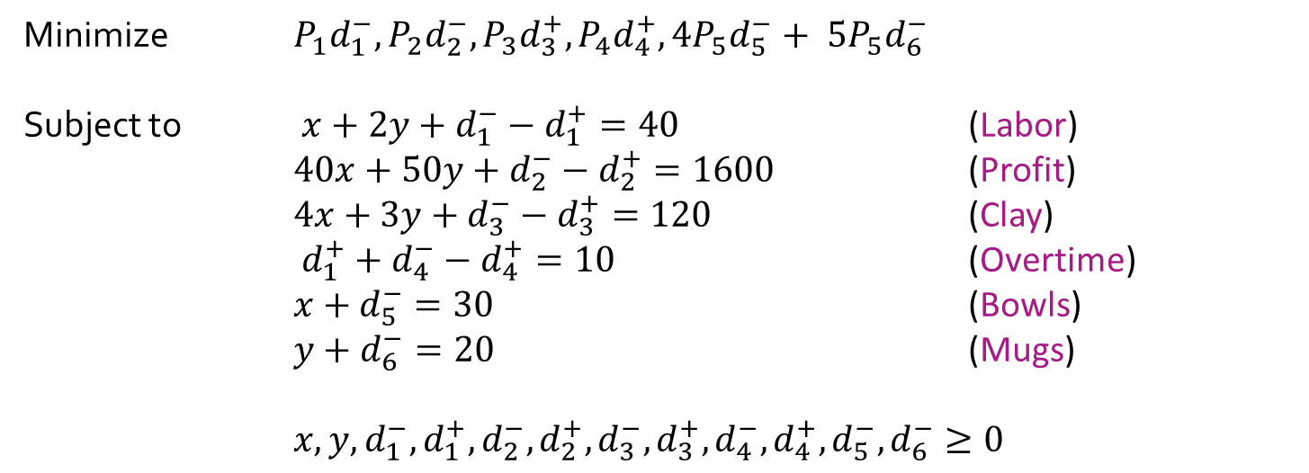
Ex: Beaver Creek Pottery
Full modified goal programming model
Minimize $P_{1}d_{1}^{−}, P_{2}d_{2}^{−}, P_{3}d_{3}^{+},P_{4}d_{4}^{+},{4P}_{5}d_{5}^{−}+ {5P}_{5}d_{6}^{−}$
Subject to $x+2y+d_{1}^{−}−d_{1}^{+}=40$ (Labor)
$40x+50y+d_{2}^{−}−d_{2}^{+}=1600$ (Profit)
$4x+3y+d_{3}^{−}−d_{3}^{+}=120$ (Clay)
$d_{1}^{+}+d_{4}^{−}−d_{4}^{+}=10$ (Overtime)
$x+d_{5}^{−}=30$ (Bowls)
$y+d_{6}^{−}=20$ (Mugs)
$x,y,d_{1}^{−},d_{1}^{+},d_{2}^{−},d_{2}^{+},d_{3}^{−},d_{3}^{+},d_{4}^{−},d_{4}^{+},d_{5}^{−},d_{6}^{−}≥0$

Slide 9
Ex: The Expanse
In the Expanse, there are three main factions:
Earthers from Earth
Martians from Mars
Belters from the Asteroid Belt
All three factions have fought for years and the well-respected earther, Jim Holden, who works in the belt, has recommended Earth and Mars to balance representation of their people at 4 asteroid developments in the belt
Current distribution at the 4 space stations
Ceres: 500 Earthers & 500 Martians
Vesta: 300 Earthers & 1,000 Martians
Pallas: 400 Earthers & 1,050 Martians
Hygiea: 800 Earthers & 450 Martians
Overall: 5,000 Earthers and Martians: 40% Earthers & 60% Martians

Slide 10
Ex: The Expanse
Currently, Ceres is the only asteroid that has even balance between people from Earth and Mars
Six prominent individuals from Mars and Earth, who are leaders at the various asteroids, come together to determine the best way to relocate their people
John Connor (JC) – Represents Pallas
Fred Harvey (FH) – Represents Ceres
Betty Philips (BP) – Represents Vesta
Mickey Gibbony (MG) – Represents Hygiea
Cassandra Watkins (CW) – Represents Ceres
Bob Wilson (BW) – Represents Pallas

Slide 11
Ex: The Expanse
Act I
“Rather than starting off by trying to move people from one asteroid to another, why don’t we try to establish what we want to accomplish?” – JC
“Good idea, Lil John” – FH
“Sixty percent of all residents are Martians and 40% are Earthers, so that’s what we need our asteroids to be, 60% and 40%.” – JC
“That’s okay for you to say, Lil John, because your asteriod (Pallas) is already close to those proportions. My asteroid (Vesta) is a long way from that ratio, and we would have to move a lot of our residents.” – BP
“I’m not saying it, Betty; Jim Holden has been saying it for 6 months.” – JC
“John’s right, Betty, and we’re not moving people yet; we’re just putting down our objectives. I think that must be our highest-priority.“ – FH
They all nod in agreement like a bunch of bobbleheads
Intermission I

Slide 12
Ex: The Expanse
Act II
“Since we’re going to have to move people to achieve this ratio at each asteroid, I think we ought to try to minimize the amount of traveling.”– MG
Fred Harvey shared a table showing the distance (in millions of miles) a person in one asteroid would have to travel to get to each of the other asteroids.
Asteroid | Vesta | Hygiea | Pallas | Ceres
Vesta | - | 30 | 12 | 20
Hygiea | 30 | - | 18 | 26
Pallas | 12 | 18 | - | 24
Ceres | 20 | 26 | 24 | -

Slide 13
Ex: The Expanse
Act II
“Why not set reasonable objectives for total miles, for the peoples’ sake and for budgeting reasons? I would suggest about 30,000 million miles of total travel at max. If we get much higher than that we’re not going to have the money to pay for it, and it means we’ll be moving people all over the place.” – CW
They all nod in agreement like a bunch of bobbleheads
“Okay, that’ll be our number two goal.” – FH
Intermission II

Slide 14
Ex: The Expanse
Act III
“I’ll tell you another thing I don’t want to see happen, and that’s more overcrowding at Vesta. We have 100 people more than capacity now.” – BP
“You think you have problems! In Pallas, we have 1,450 people and a capacity of 1,000. I think no overcrowding is a great idea!” – BW
“I agree. We’re 250 over our capacity at Hygiea” – MG
“That’s a nice idea, and I realize that we have 200 people less than our capacity at Ceres. However, let’s face it, across the asteroids we have capacity for 4,400, not 5,000, people, so there’s going to be some overcrowding. I think our objective should be that all 4 asteroids should share in the overcrowding proportionally.” – CW
“That sounds reasonable to me. How about the rest of you? Okay to say our number three goal is to be as close to capacity at each asteroid as possible but share proportionally in the overcrowding” - FH
They voice their approval by joining hands and singing

Slide 15
Ex: The Expanse
Act III
“Well, I think we have identified the things we want to accomplish in our plan. Now, if we could just use some magic trick to find the best way to move these people to achieve these goals.” – JC
The others nodded and frowned because they don’t know math.
The End and Credits
John Connor Mario Giacomazzo
Fred Harvey Mario Giacomazzo
Betty Philips Mario Giacomazzo
Mickey Gibbony Mario Giacomazzo
Cassandra Watkins Mario Giacomazzo
Bob Wilson Mario Giacomazzo
Narration Mario Giacomazzo

Slide 16
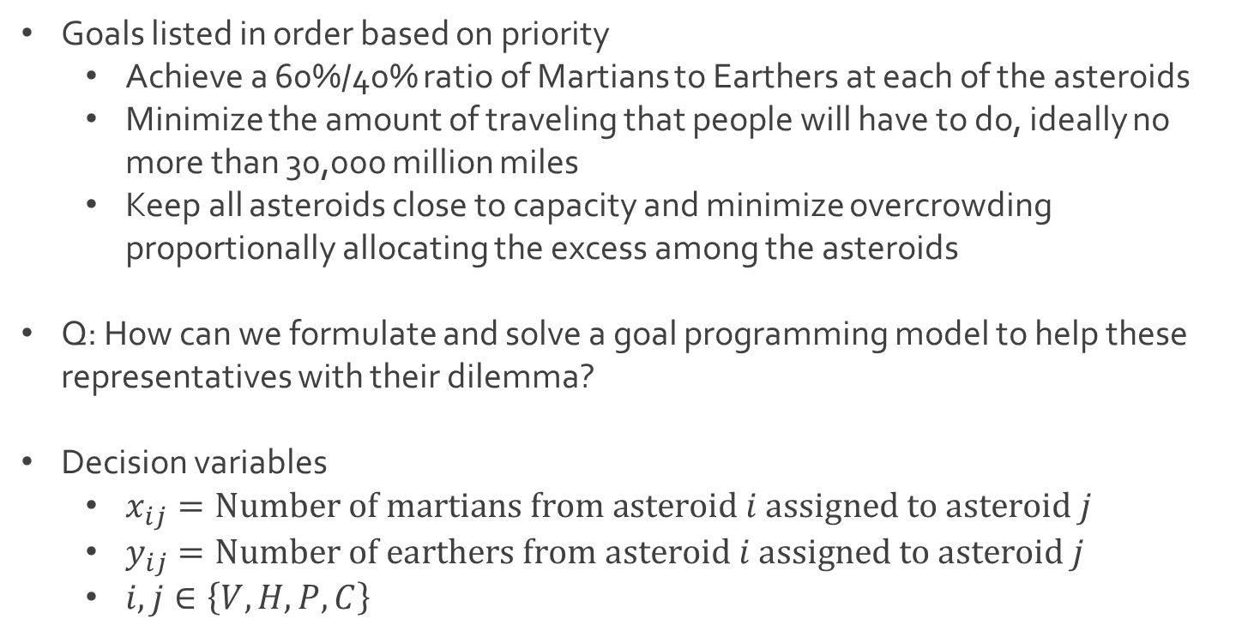
Ex: The Expanse
Goals listed in order based on priority
Achieve a 60%/40% ratio of Martians to Earthers at each of the asteroids
Minimize the amount of traveling that people will have to do, ideally no more than 30,000 million miles
Keep all asteroids close to capacity and minimize overcrowding proportionally allocating the excess among the asteroids
Q: How can we formulate and solve a goal programming model to help these representatives with their dilemma?
Decision variables
$x_{ij}=Number of martians from asteroid i assigned to asteroid j$
$y_{ij}=Number of earthers from asteroid i assigned to asteroid j$
$i,j∈\left\{V,H,P,C\right\}$

Slide 17
Ex: The Expanse
Helpful tables of key information
Current amounts of Martians and Earthers with capacity
Distances (millions of miles) each person must travel between asteroids
Asteroid | # of Martians | # of Earthers | Capacity
Vesta | 1000 | 300 | 1200
Hygiea | 450 | 800 | 1000
Pallas | 1050 | 400 | 1000
Ceres | 500 | 500 | 1200
Asteroid | Vesta | Hygiea | Pallas | Ceres
Vesta | - | 30 | 12 | 20
Hygiea | 30 | - | 18 | 26
Pallas | 12 | 18 | - | 24
Ceres | 20 | 26 | 24 | -

Slide 18




The End
Dale

